Slide 1
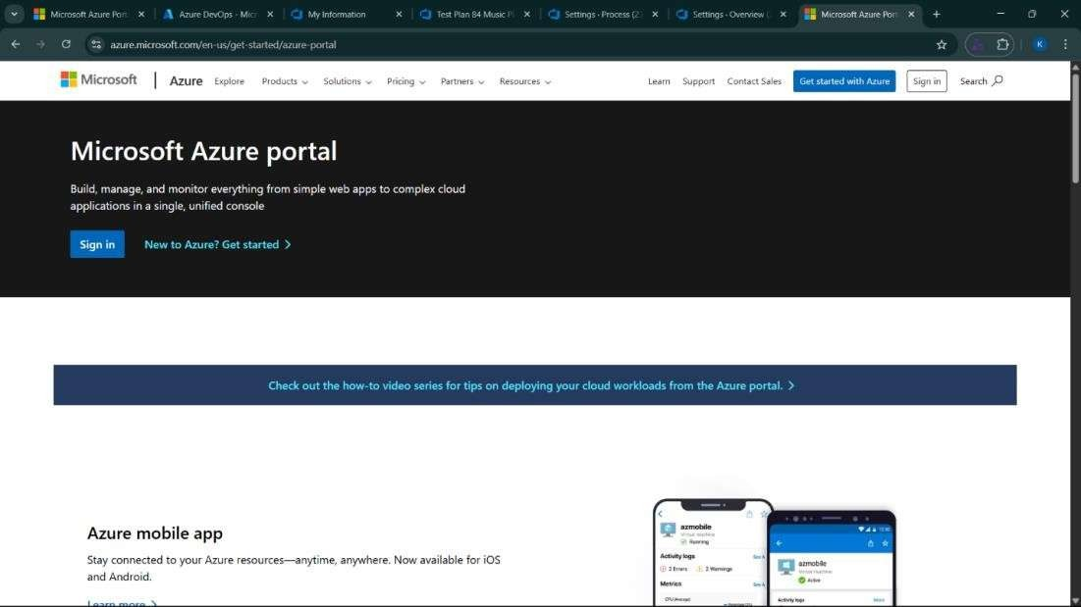
EXP NO: 1
AZURE DEVOPS ENVIRONMENT SETUP
Create Epic, Features, User Stories, Task
Aim:
To set up and access the Azure DevOps environment by creating an organization through the Azure
portal.
INSTALLATION
1.Open your web browser and go to the Azure website: https://azure.microsoft.com/en-us/get- started/azure-portal.
Sign in using your Microsoft account credentials.
If you don't have a Microsoft account, you can create one here: https://signup.live.com/?lic=1

Slide 2
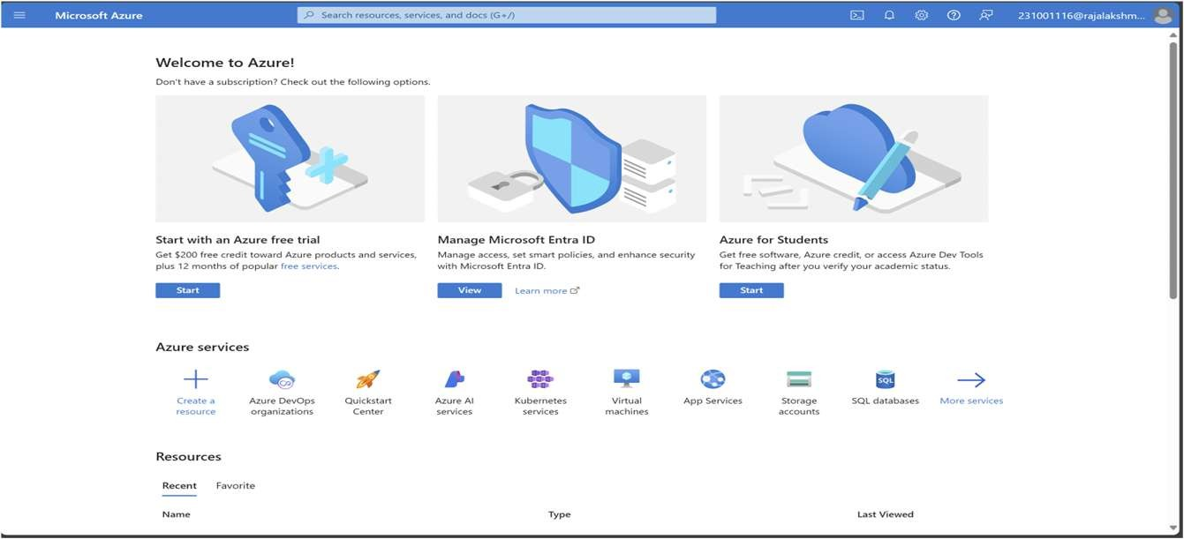
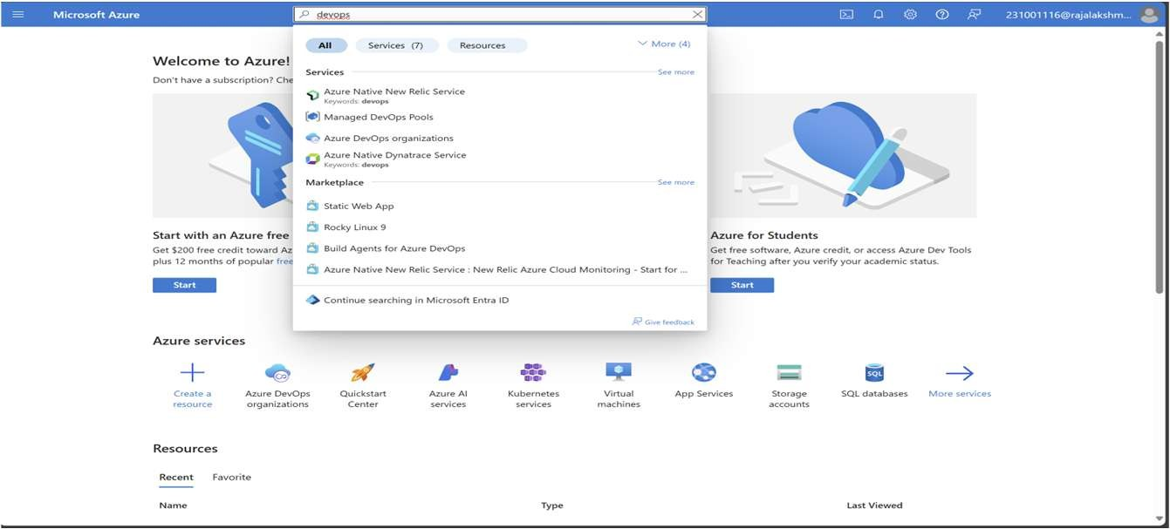
2.Azure home page
3.Open DevOps environment in the Azure platform by typing Azure DevOps Organizations in the search bar.

Slide 3
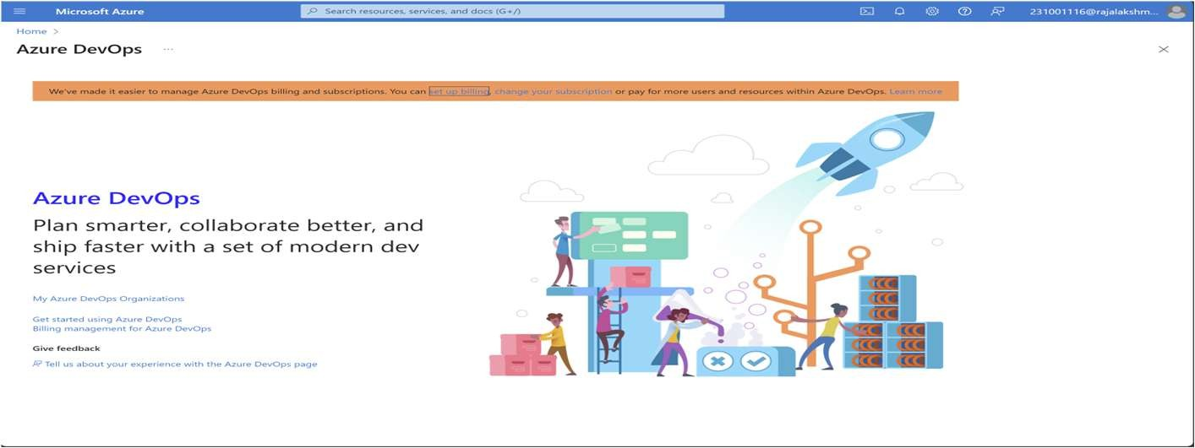
4.Click on the My Azure DevOps Organization link and create an organization and you should be taken to the Azure DevOps Organization Home page.
Result:
Successfully accessed the Azure DevOps environment and created a new organization through the
Azure portal.

Slide 4
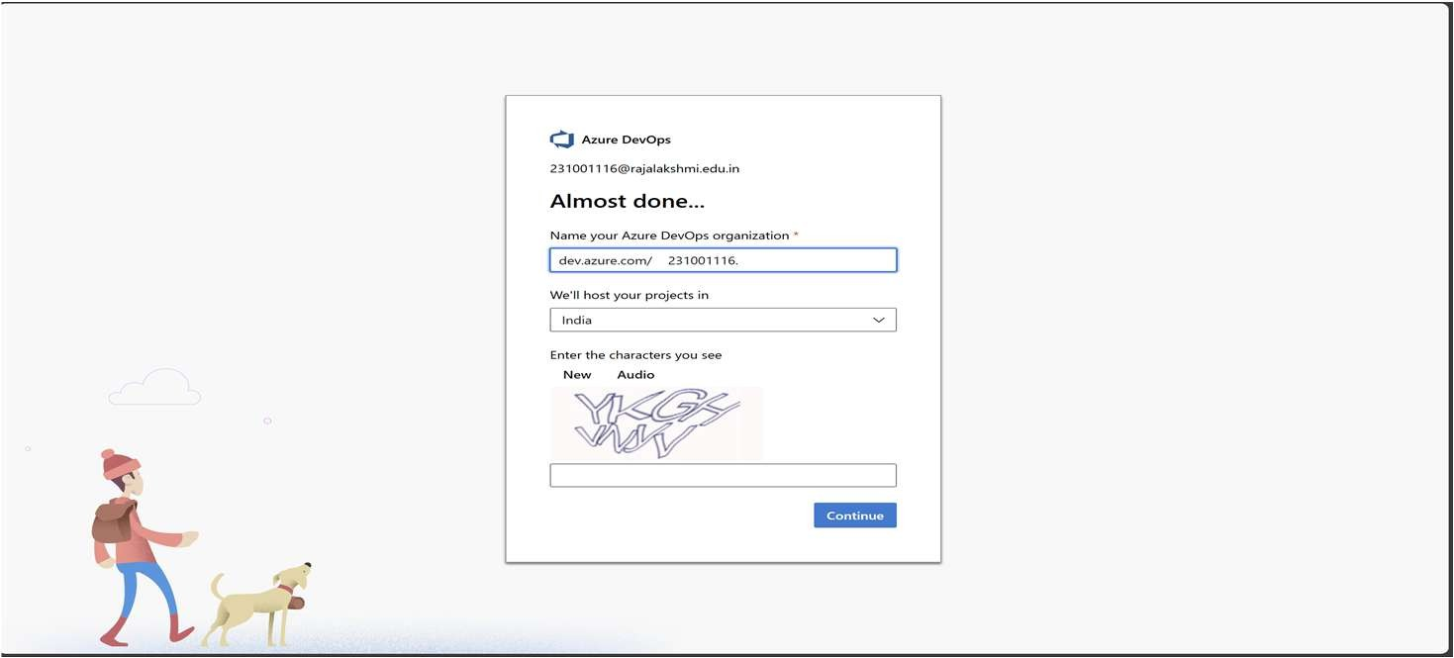
EXP NO: 2
AZURE DEVOPS PROJECT SETUP AND USER STORY MANAGEMENT
Create Epic, Features, User Stories, Task
Aim:
To set up an Azure DevOps project for efficient collaboration and agile work management.
1.Create An Azure Account
Create the First Project in Your Organization
After the organization is set up, you’ll need to create your first project. This is where you'll begin to manage code, pipelines, work items, and more.
On the organization’s Home page, click on the New Project button.
Enter the project name, description, and visibility options:
Name: Choose a name for the project (e.g., LMS).
Description: Optionally, add a description to provide more context about the project. Visibility: Choose whether you want the project to be Private (accessible only to those invited) or Public (accessible to anyone).
Once you’ve filled out the details, click Create to set up your first project.

Slide 5
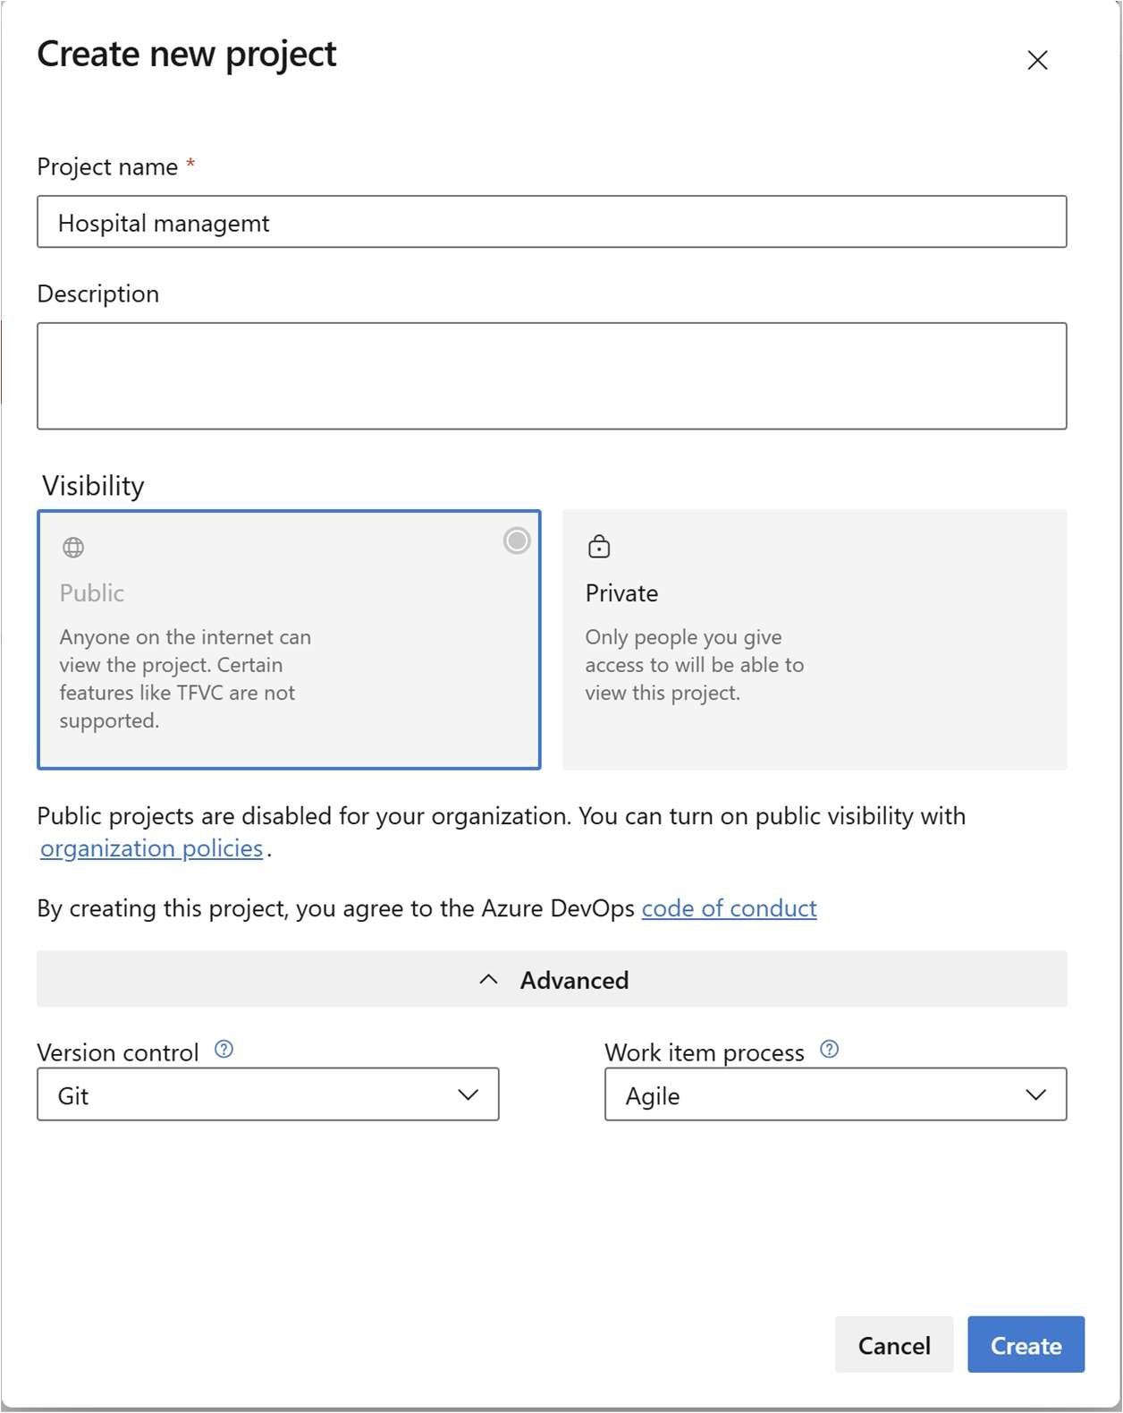
3.Once logged in, ensure you are in the correct organization. If you're part of multiple organizations, you can switch between them from the top left corner (next to your user profile). Click on the Organization name, and you should be taken to the Azure DevOps Organization Home page.

Slide 6
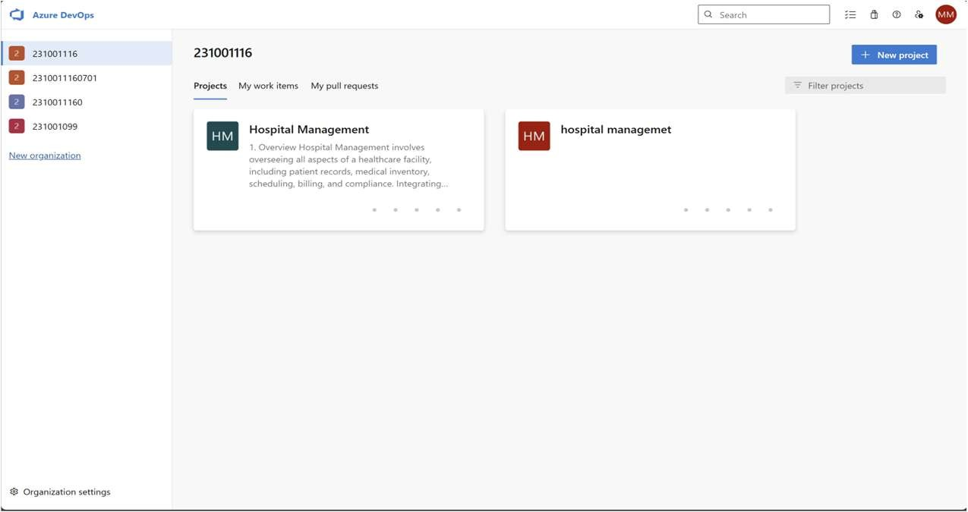
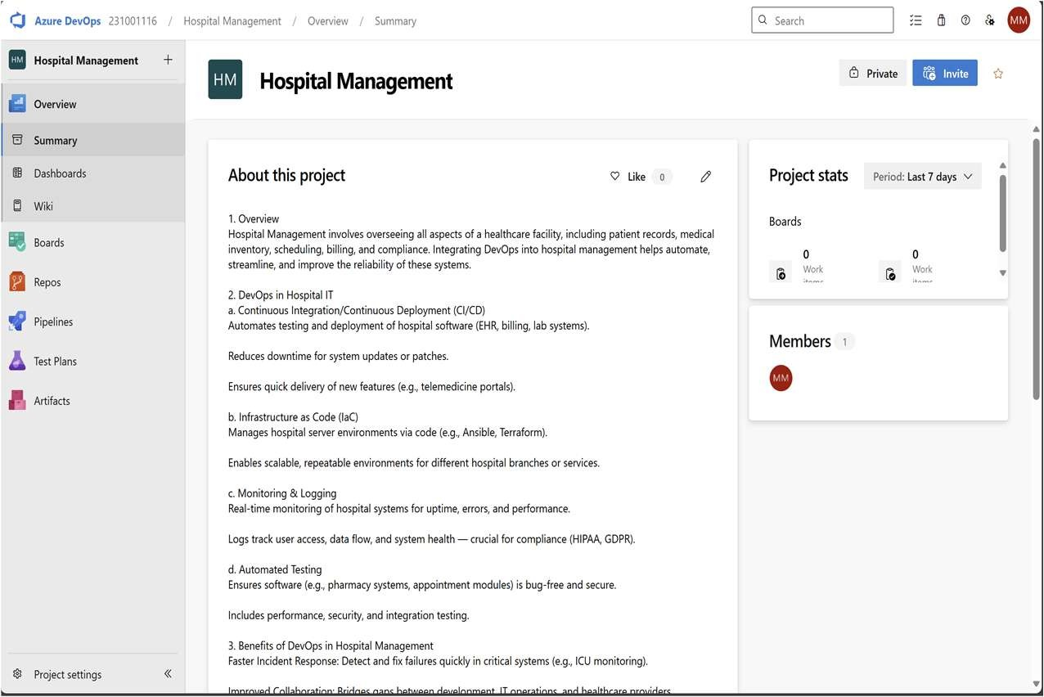
4.Project dashboard

Slide 7
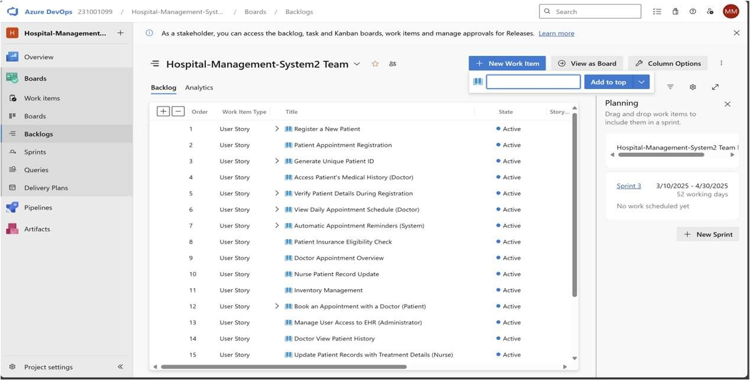
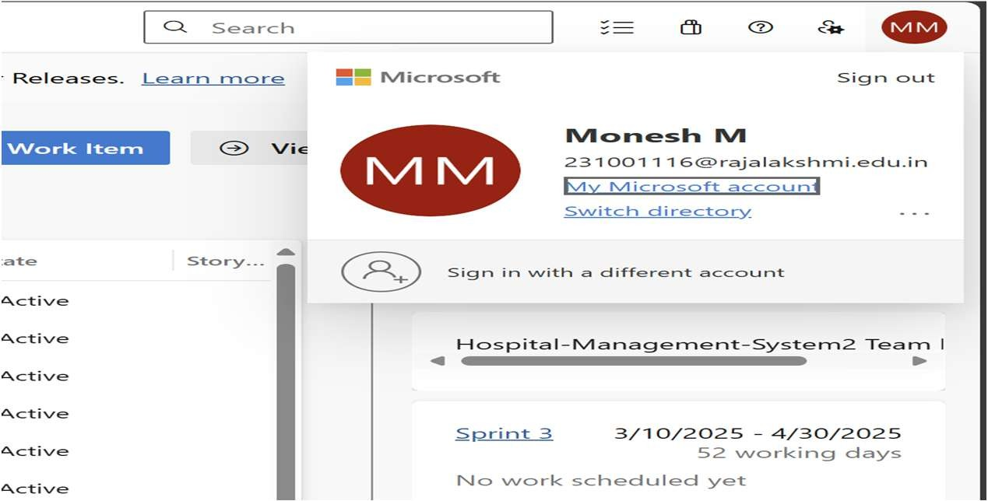
To manage user stories:
From the left-hand navigation menu, click on Boards. This will take you to the main Boards
page, where you can manage work items, backlogs, and sprints.
On the work items page, you'll see the option to Add a work item at the top. Alternatively, you can find a + button or Add New Work Item depending on the view you're in. From the Add a work item dropdown, select User Story. This will open a form to enter details for the new User Story.

Slide 8
Result:
Successfully created an Azure DevOps project with user story management and agile workflow
setup.

Slide 9
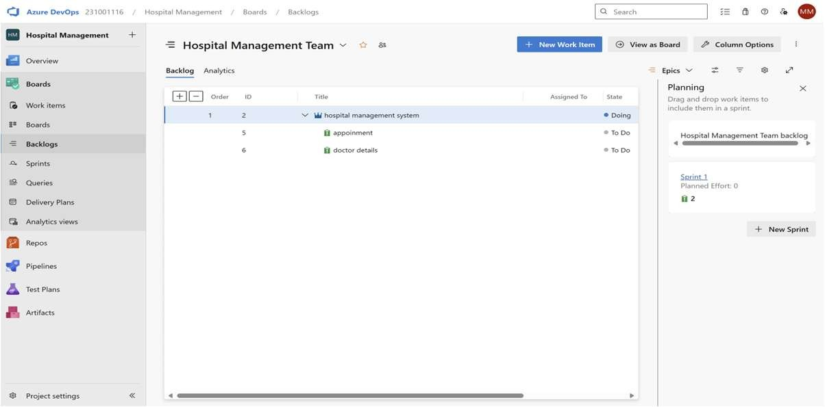
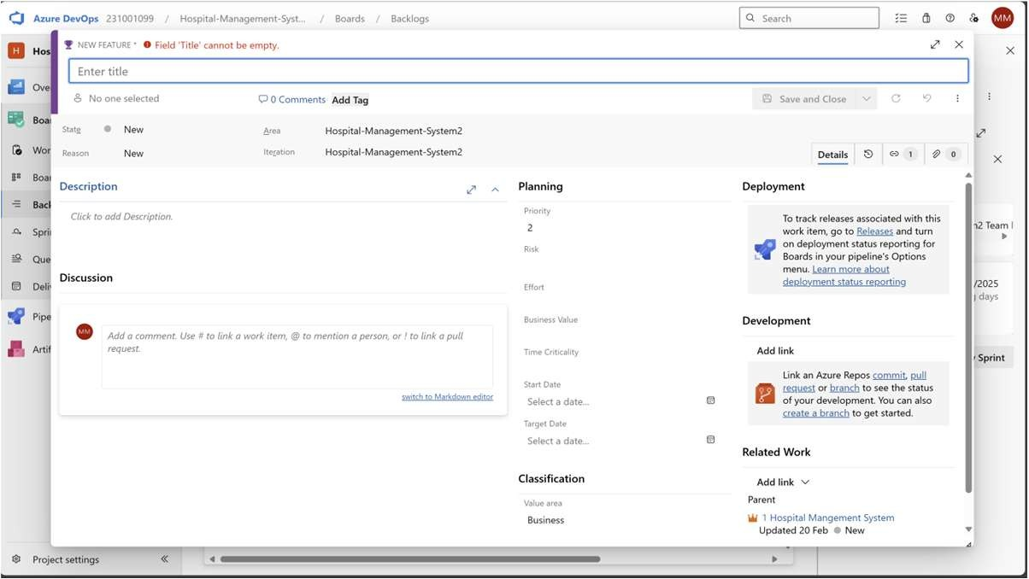
EXP NO: 3
SETTING UP EPICS, FEATURES, AND USER STORIES FOR PROJECT PLANNING
Create Epic, Features, User Stories, Task
Aim:
To learn about how to create epics, user story, features, backlogs for your assigned project.
Create Epic, Features, User Stories, Task
1.Fill in Epics

Slide 10
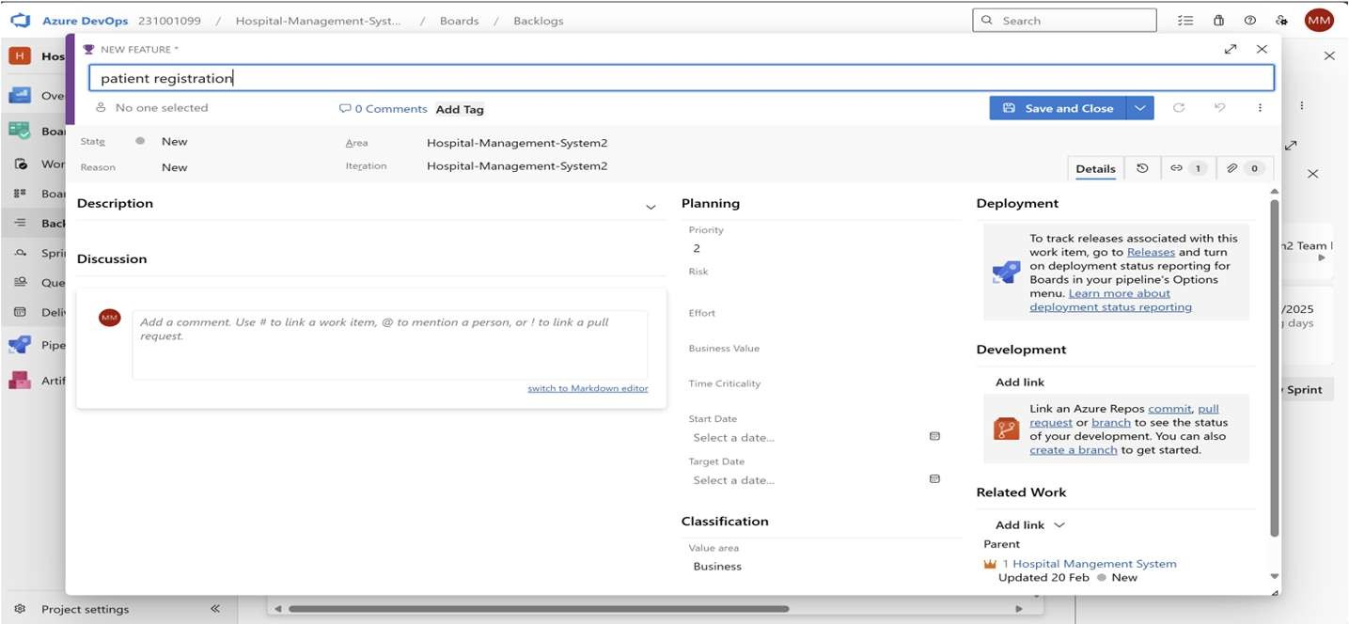
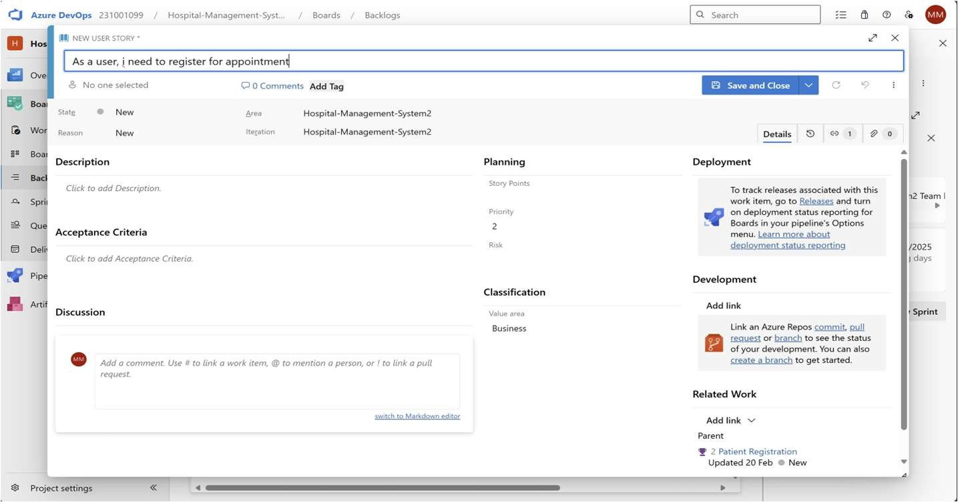
2.Fill in Features
3.Fill in User Story Details

Slide 11
Result:
Thus, the creation of epics, features, user story and task has been created successfully.

Slide 12
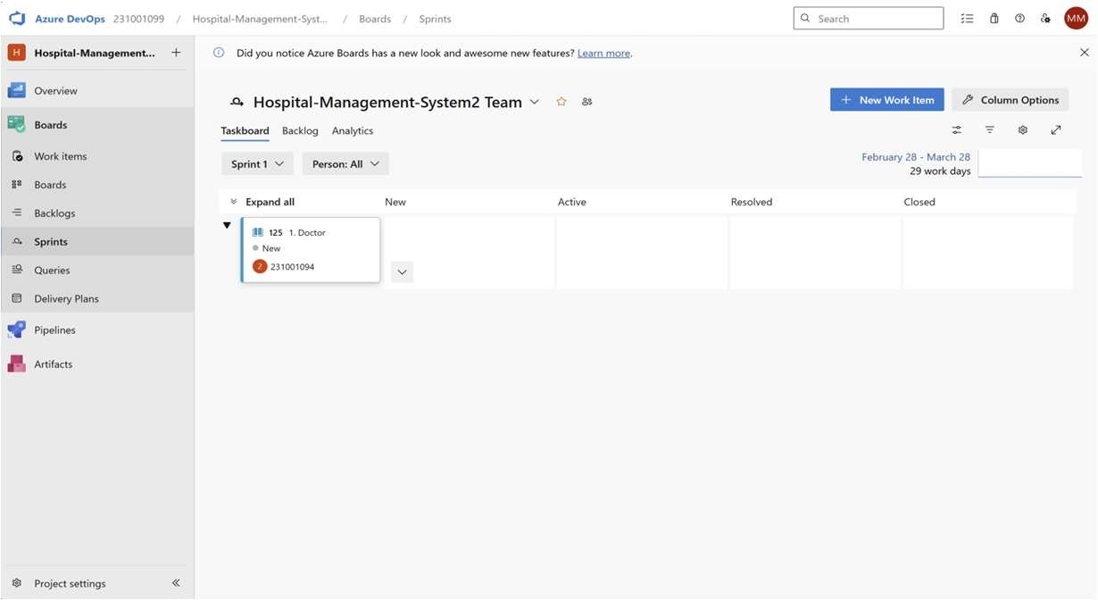
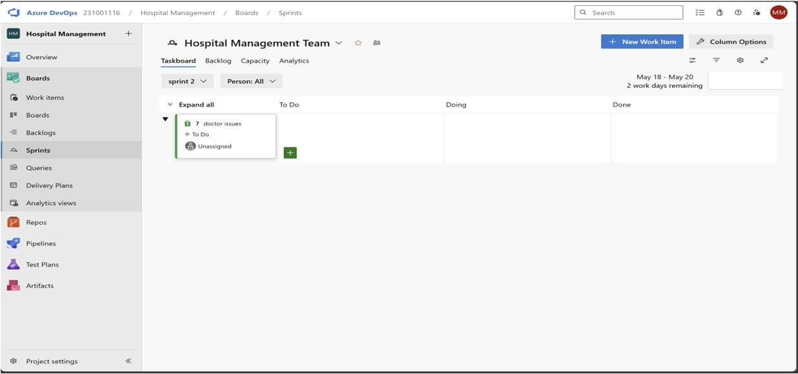
EXP NO: 4
SPRINT PLANNING
Create Epic, Features, User Stories, Task
Aim:
To assign user story to specific sprint for the Hospital management Creator Project.
Sprint Planning Sprint 1
Sprint 2

Slide 13
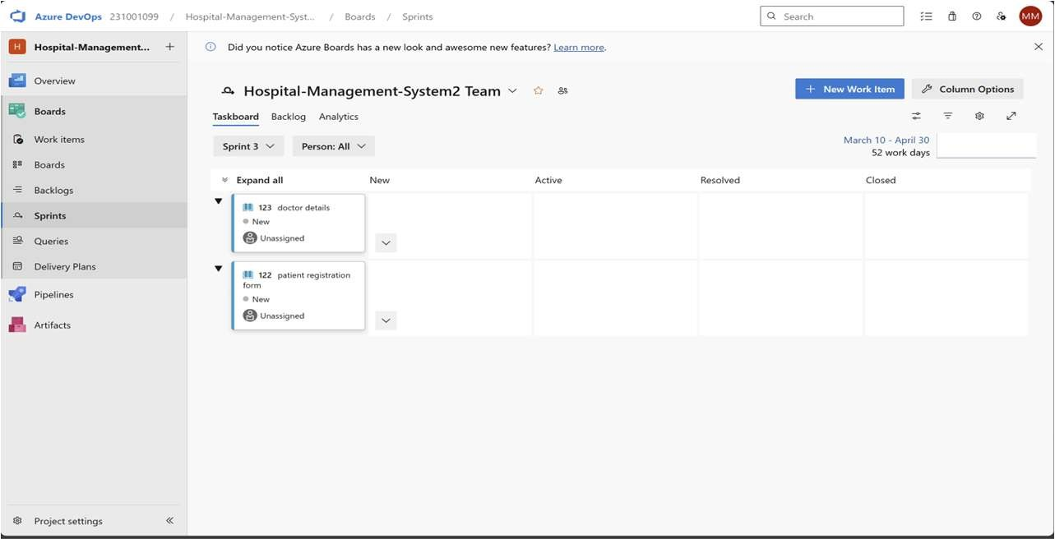
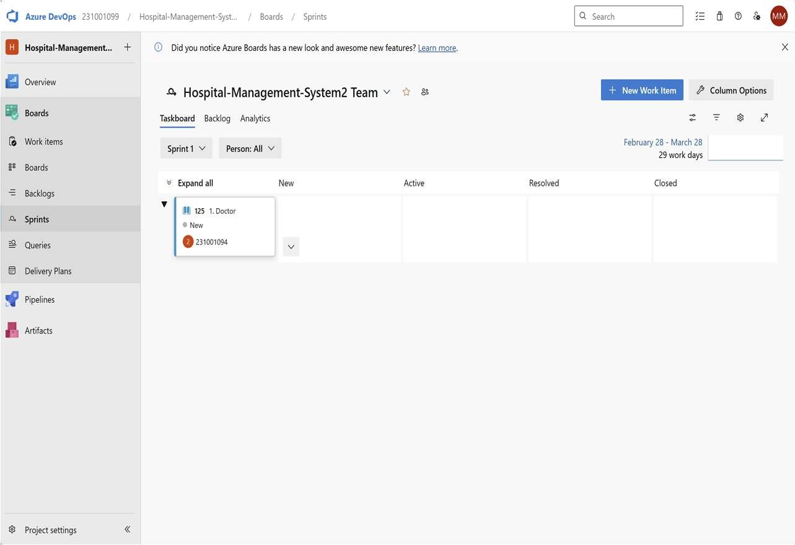
Sprint 3
Sprint 4

Slide 14
Result:
The Sprints are created for the Hospital management Project.

Slide 15
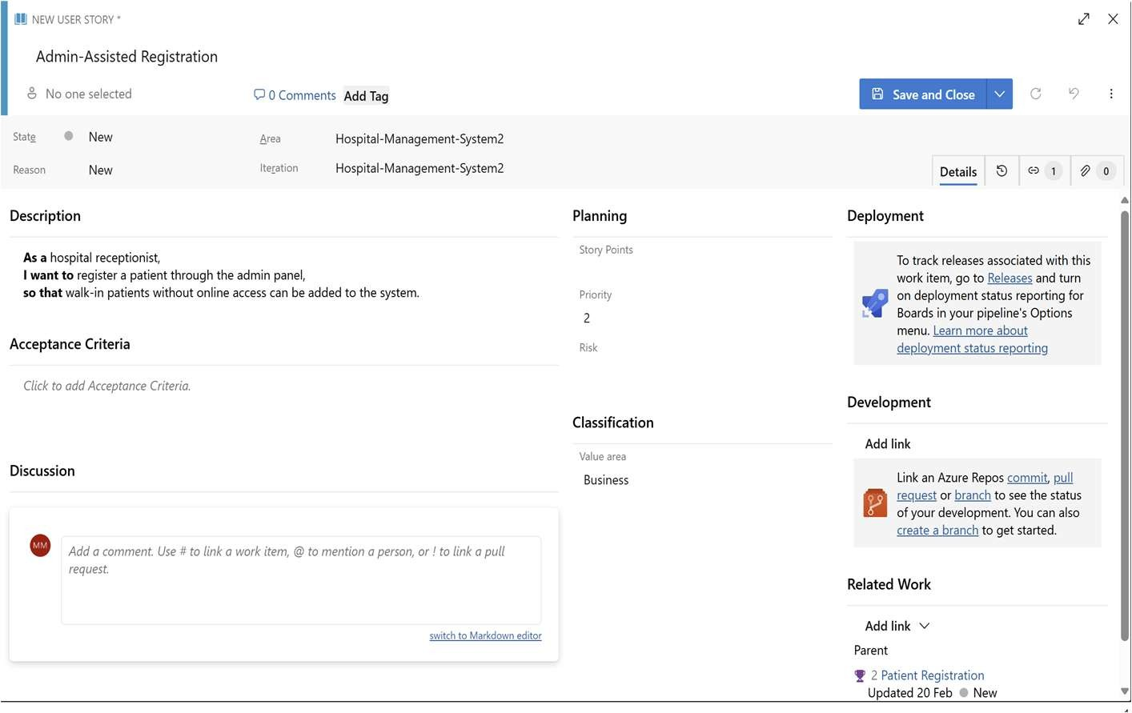
EXP NO: 5
POKER ESTIMATION
Create Epic, Features, User Stories, Task
Aim:
Create Poker Estimation for the user stories – Hospital Management Project.
Poker Estimation
Result:
The Estimation/Story Points is created for the project using Poker Estimation.

Slide 16
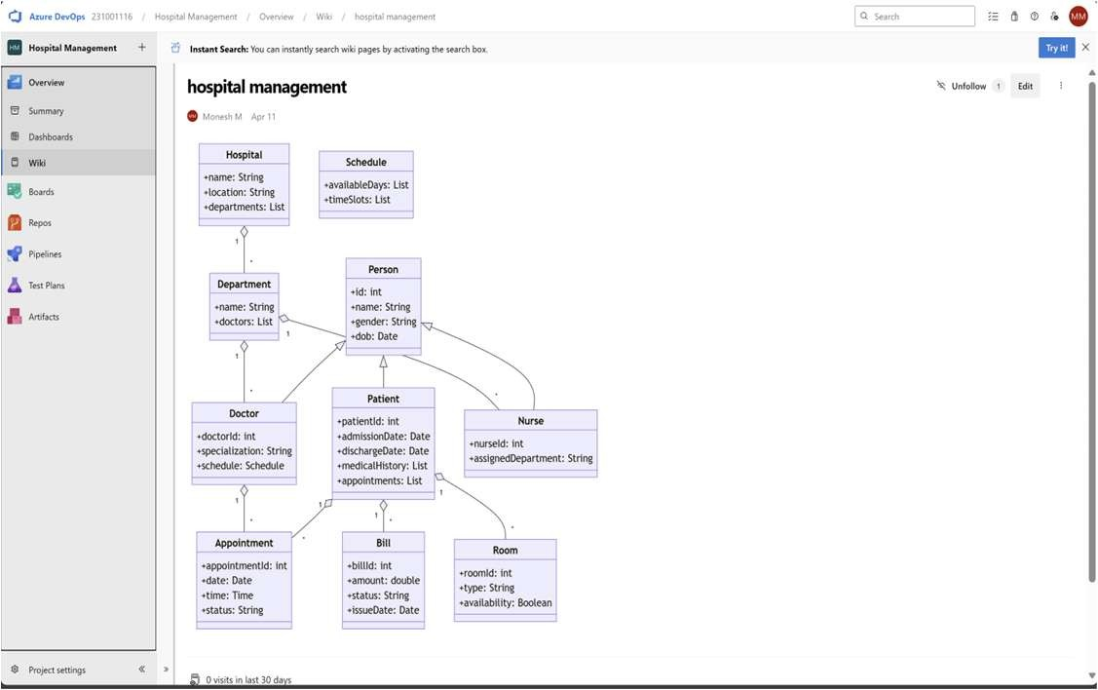
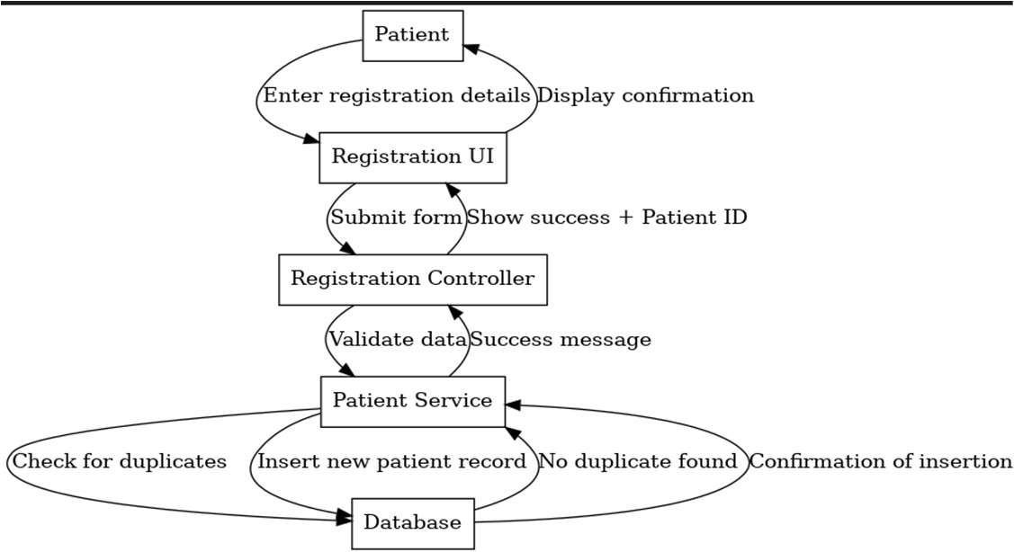
EXP NO: 6
DESIGNING CLASS AND SEQUENCE DIAGRAMS FOR PROJECT ARCHITECTURE
Create Epic, Features, User Stories, Task
Aim:
To Design a Class Diagram and Sequence Diagram for the given Project.
6A. Class Diagram
6B. Sequence Diagram

Slide 17
Result:
The Class Diagram and Sequence Diagram is designed Successfully for the Hospital management.

Slide 18
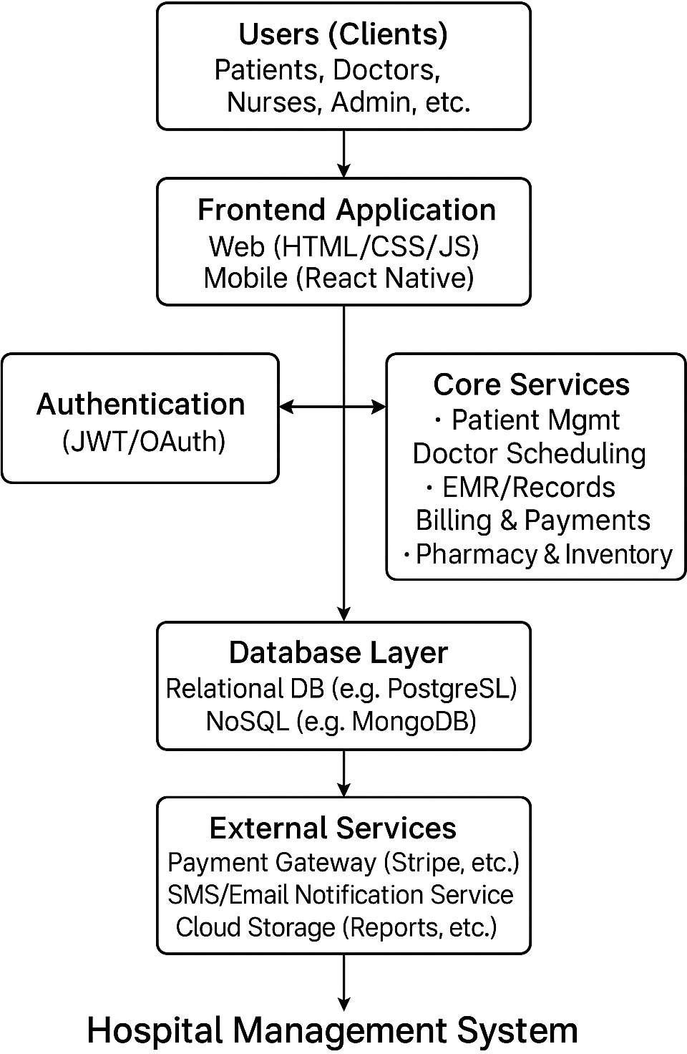
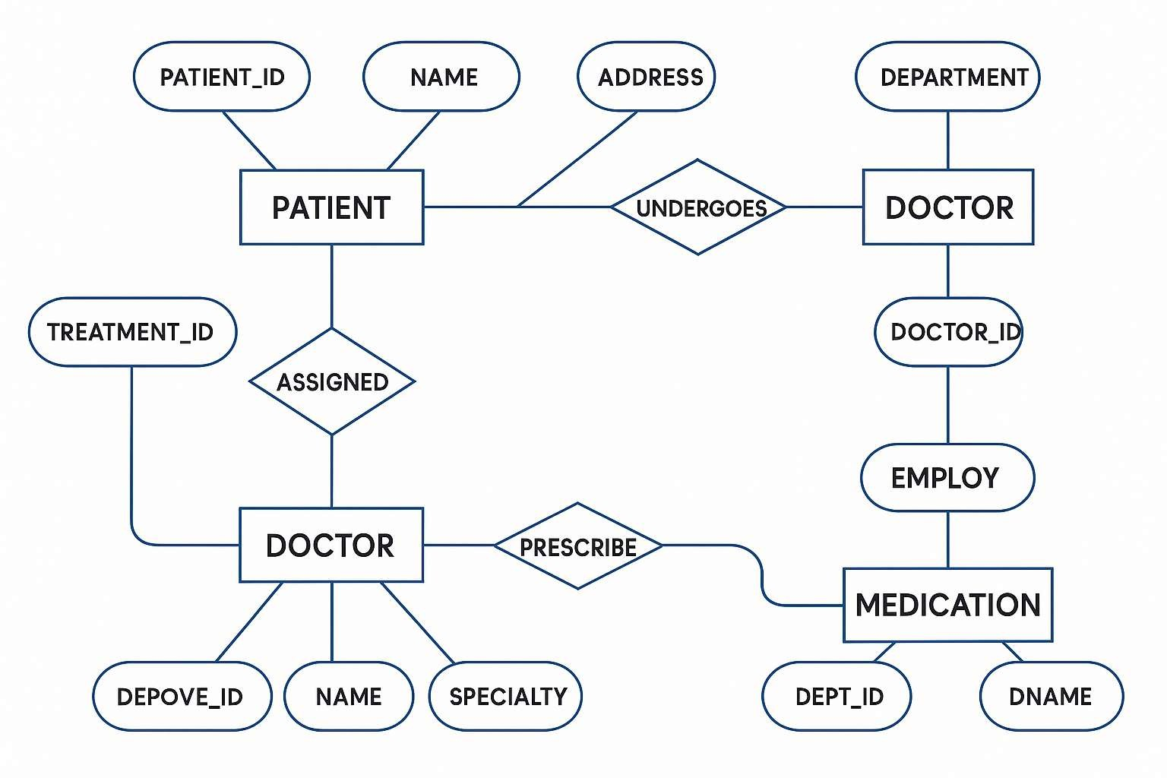
EXP NO: 7
DESIGNING ARCHITECTURAL AND ER DIAGRAMS FOR PROJECT STRUCTURE
Create Epic, Features, User Stories, Task
Aim:
To Design an Architectural Diagram and ER Diagram for the given Project.
7A. Architectural Diagram
7B.ER Diagram

Slide 19
Result:
The Architecture Diagram and ER Diagram is designed Successfully for the Hospital management

Slide 20
EXP NO: 8
TESTING – TEST PLANS AND TEST CASES
Create Epic, Features, User Stories, Task
Aim:
Test Plans and Test Case and write two test cases for at least five user stories showcasing the happy path and error scenarios in azure DevOps platform.
Test Planning and Test Case Test Case Design Procedure
Understand Core Features of the Application
User Signup & Login
Viewing and Managing Playlists
Fetching Real-time Metadata
Editing playlists (rename, reorder, record)
Creating smart audio playlists based on categories (mood, genre, artist, etc.)
Define User Interactions
Each test case simulates a real user behaviour (e.g., logging in, renaming a playlist, adding a
song).
Design Happy Path Test Cases
Focused on validating that all features function as expected under normal conditions.
Example: User logs in successfully, adds item to playlist, or creates a category-based playlist.
Design Error Path Test Cases
Simulate negative or unexpected scenarios to test robustness and error handling.
Example: Login fails with invalid credentials, save fails when offline, no recommendations
found.
Break Down Steps and Expected Results
Each test case contains step-by-step actions and a corresponding expected outcome.
Ensures clarity for both testers and automation scripts.
Use Clear Naming and IDs
Test cases are named clearly (e.g., TC01 – Successful Login, TC10 – Save Playlist Fails).
Helps in quick identification and linking to user stories or features.
Separate Test Suites
Grouped test cases based on functionality (e.g., Login, Playlist Editing, Recommendation
System).

Slide 21
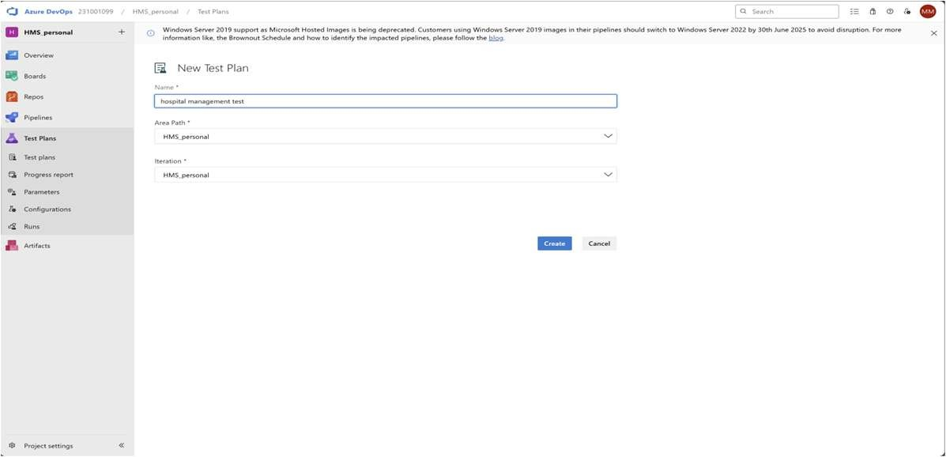
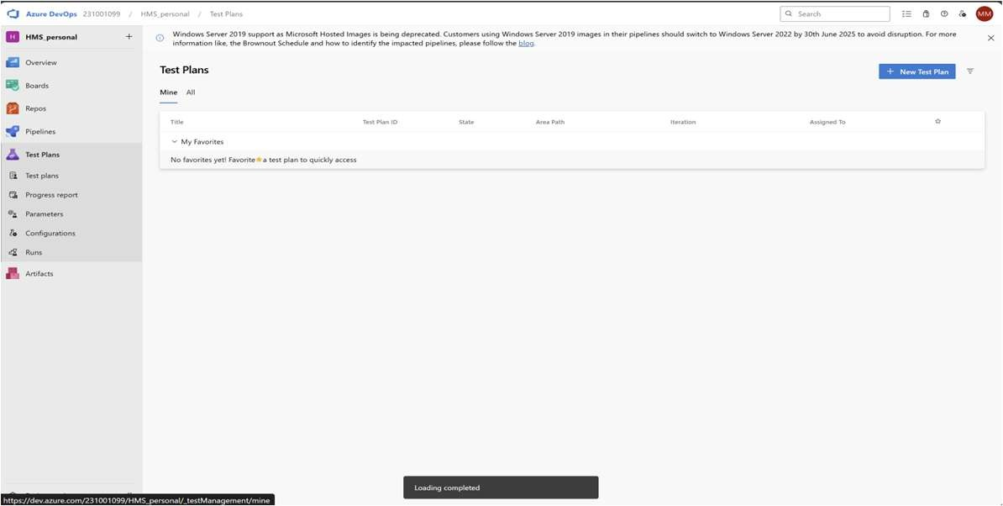
Improves organization and test execution flow in Azure DevOps.
Prioritize and Review
Critical user actions are marked high-priority.
Reviewed for completeness and traceability against feature requirements.
1.New test plan
2.Test suite

Slide 22
Test case
Give two test cases for at least five user stories showcasing the happy path and error scenarios in azure DevOps platform.
Hospital management Creator – Test Plans
USER STORIES
As a user, I want to sign up and log in securely so that I can access my user id (ID: 79).
As a user, I need to see appointment details in one place (ID: 76).
As a user, I should be able to create an message as needed (ID: 73).
As a user, I should be able to rename, record, and change the appoinment (ID: 68).
As a user, I need to have real-time metadata (ID: 65).
Test Suites
Test Suit: TS01 - User Login (ID: 86)
TC01 – Successful Sign Up
Action:
Go to the Sign-Up page.
Enter valid name, email, and password.
Click "Sign Up".
Expected Results:
Sign-Up form is displayed.
Fields accept values without error.
Account is created, and the user is redirected to the dashboard.
Type: Happy Path
TC02 – Secure Login
Action:
Go to the Login page.
Enter valid email and password.
Click on "Login".
Expected Results:
Login form is displayed.
Fields accept data without error.
User is logged in and redirected to the dashboard.
Type: Happy Path
TC03 – Sign Up with Existing Email
Action:
Go to the Sign-Up page.
Enter a name and an already registered email.
Click on "Sign Up".
Expected Results:

Slide 23
Fields accept data.
Error message "Email already registered" is displayed.
Type: Error Path
TC04 – Login with Wrong Password
Action:
Go to the Login page.
Enter valid email and incorrect password.
Click on "Login".
Expected Results:
Input is accepted.
Error message "Invalid username or password" is shown.
Type: Error Path
Test Suit: TS02 - View Playlists (ID: 87)
TC05 – View Appoinment Page
Action:
Log in successfully.
Navigate to "apponiment" section.
Expected Results:
All created playlists are displayed clearly.
Type: Happy Path
TC06 – Appoinment Loading Failure
Action:
Disconnect from the internet.
Navigate to "Message".
Expected Results:
Network is offline.
Error message "Message is not send" is shown.
Type: Error Path

Slide 24
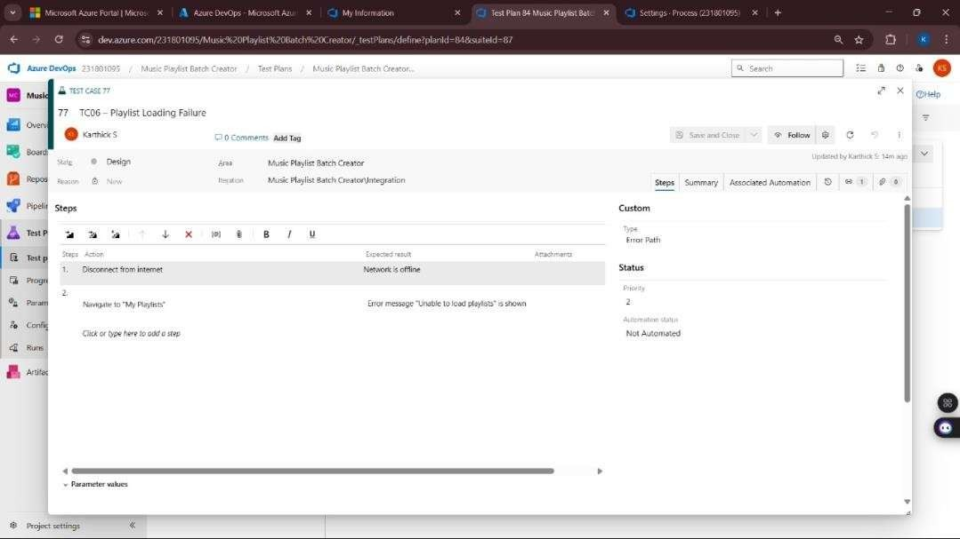
Test Suit: TS05 - Smart Playlist Creation (ID: 90)
TC13 – Generate Playlist Based on Various Categories
Action:
Login with valid credentials.
Click on "Generate Playlist".
Select categories.
Click "Generate Playlist".
Expected Results:
Playlist is generated based on selected mood and categories.
Type: Happy Path
TC14 – Fail to Generate Playlist Due to Missing Category Selection or Invalid Input
Action:
Login with valid credentials.
Click on "Generate Playlist".
Select categories.
Click "Generate Playlist".
Expected Results:
Error message: "Please select at least one valid category" or "No
recommendations found for the selected filters".
Type: Error Path
Test Cases

Slide 25
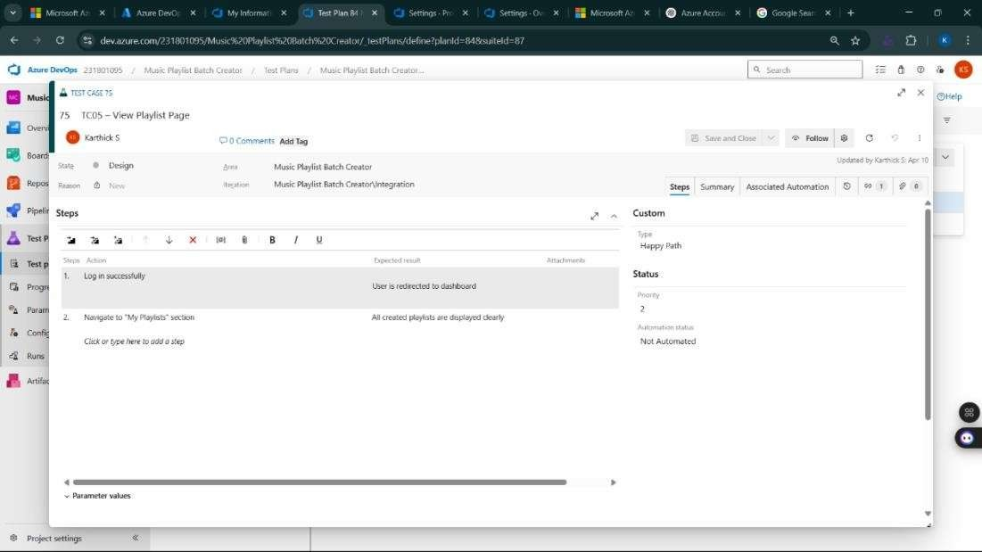
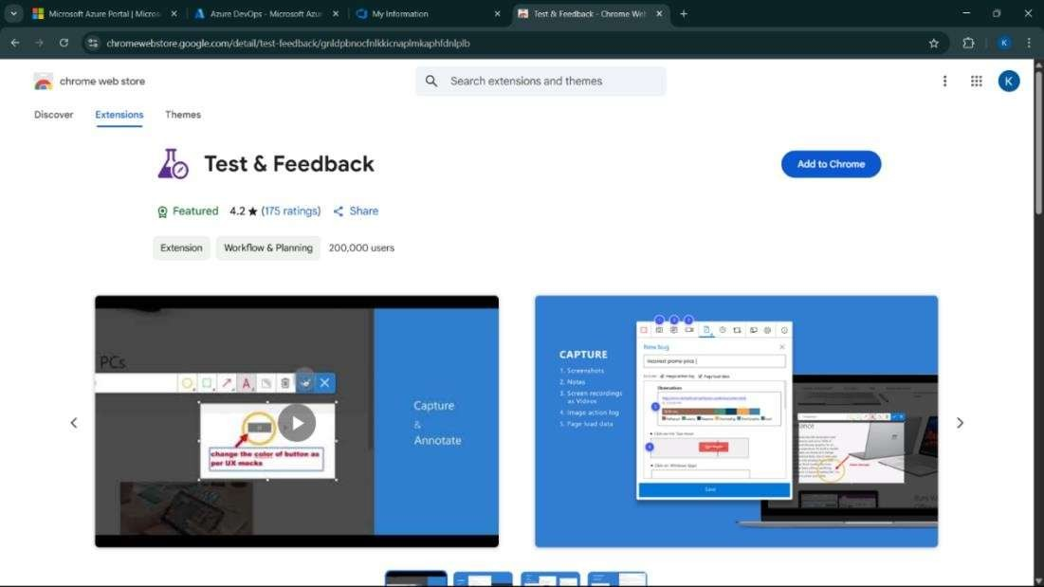
4.Installation of test

Slide 26
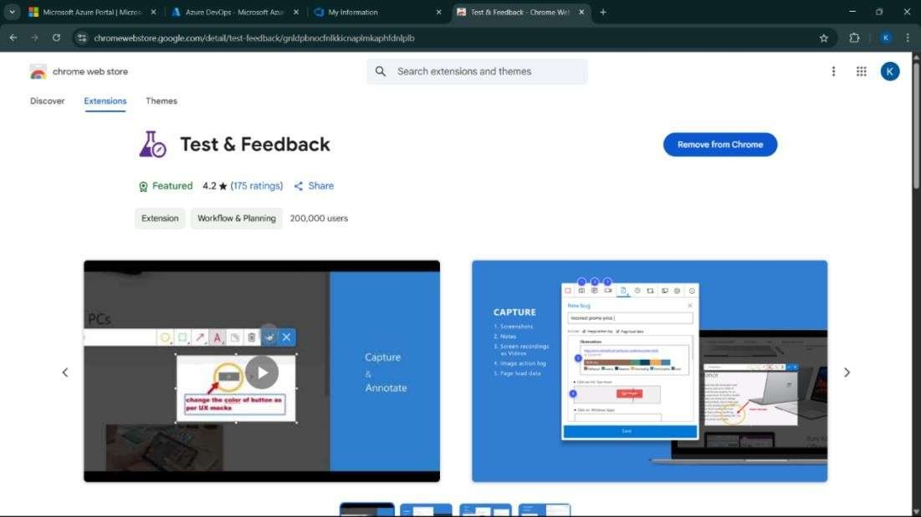
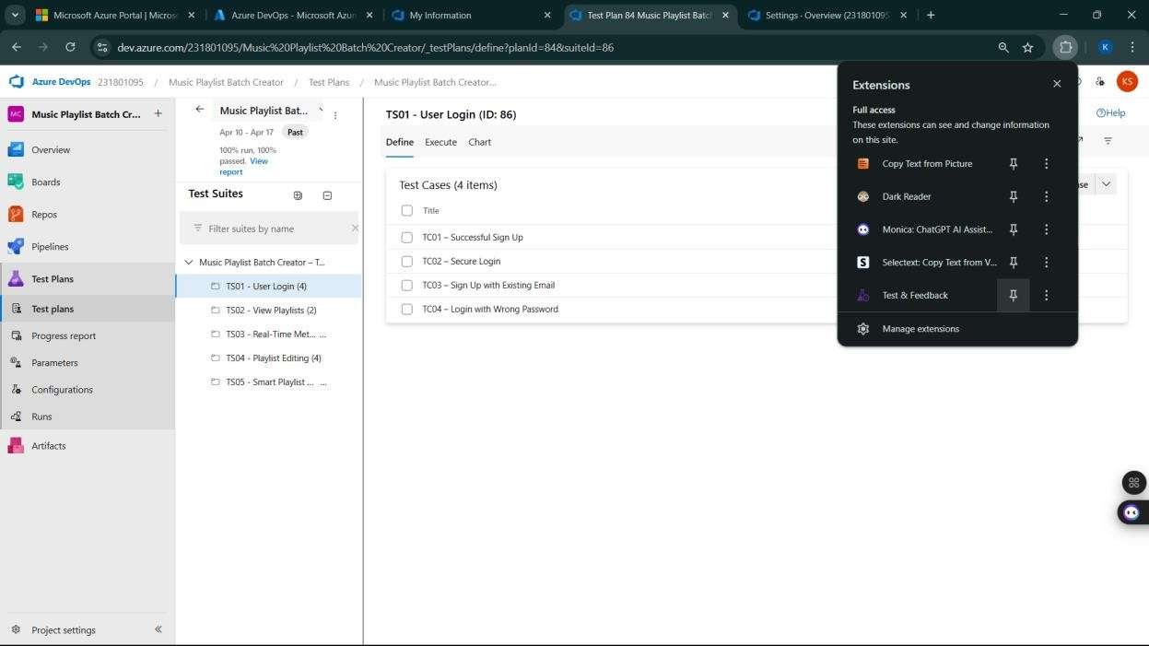
Test and feedback Showing it as an extension

Slide 27
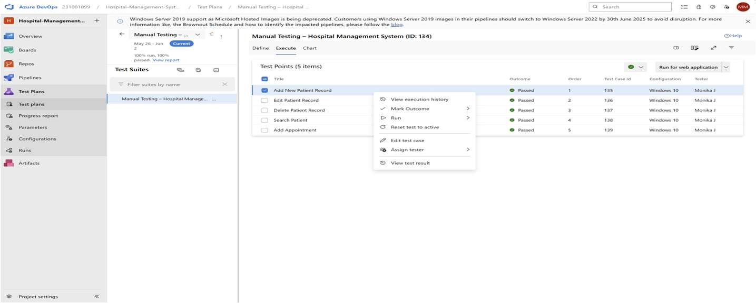
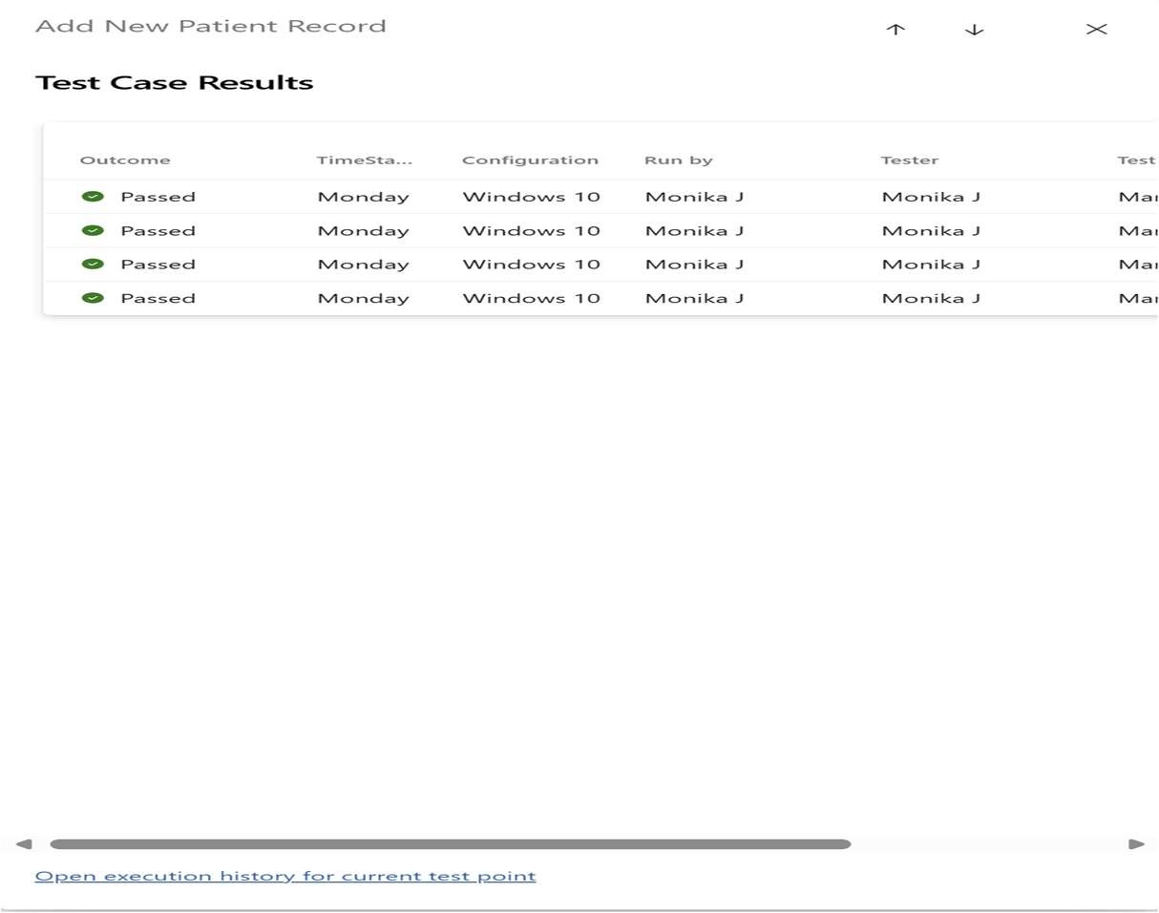
5.Running the test cases

Slide 28
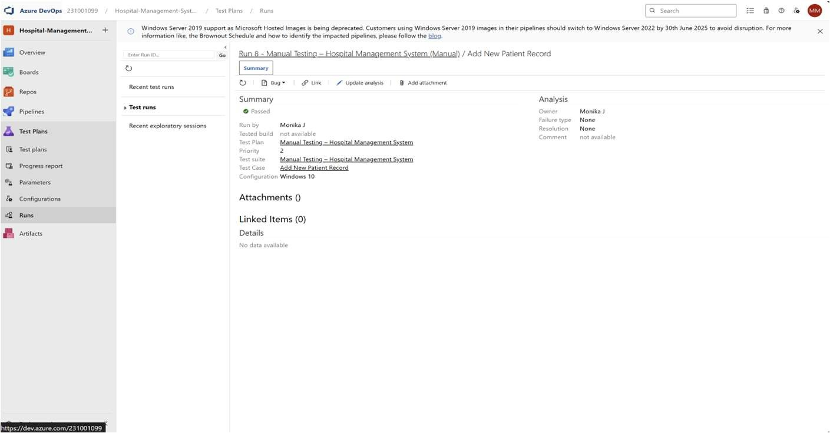
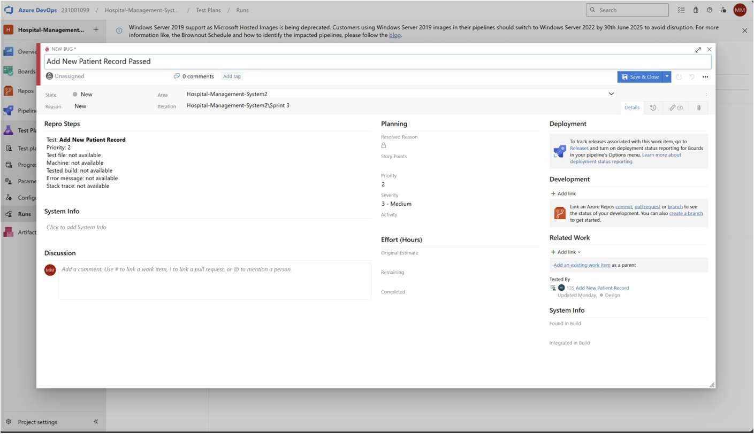
6.Recording the test case
7.Creating the bug

Slide 29
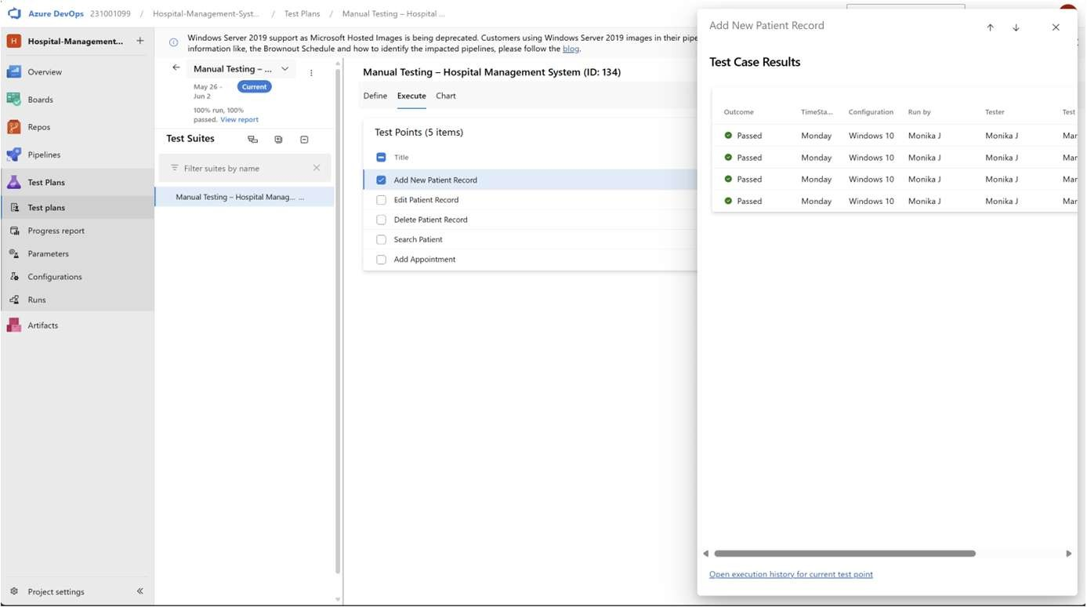
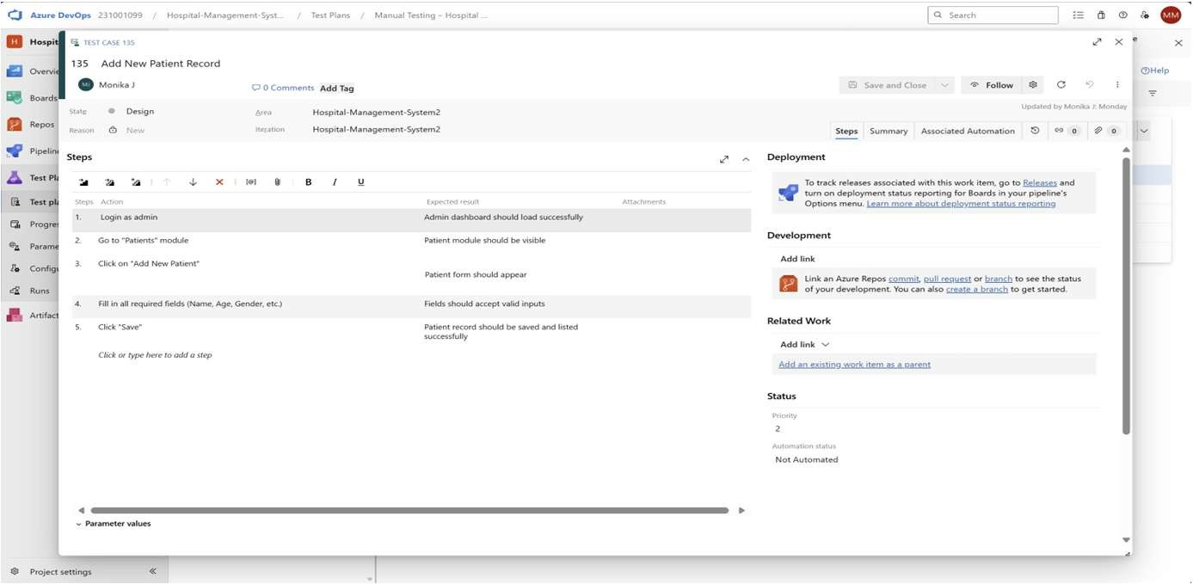
8.Test case results
9.Test report summary
Assigning bug to the developer and changing state

Slide 30
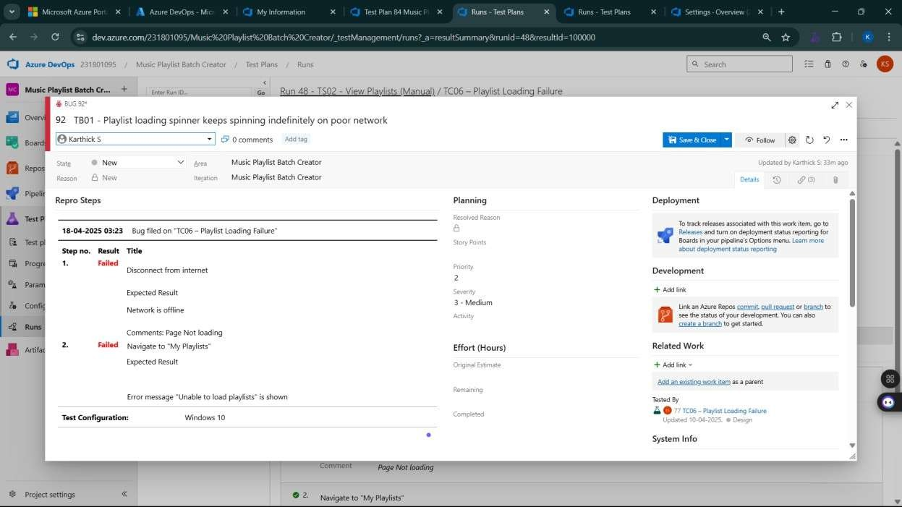
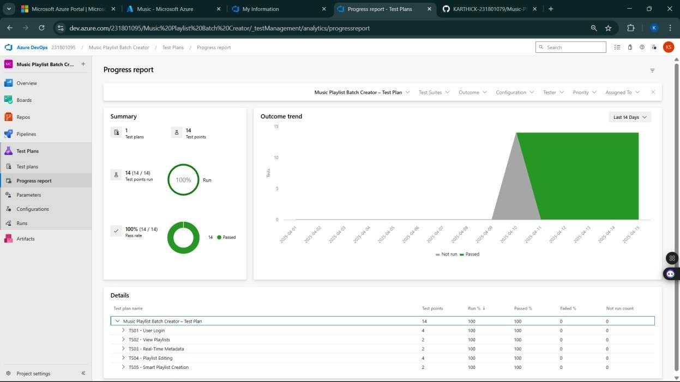
10.Progress report

Slide 31
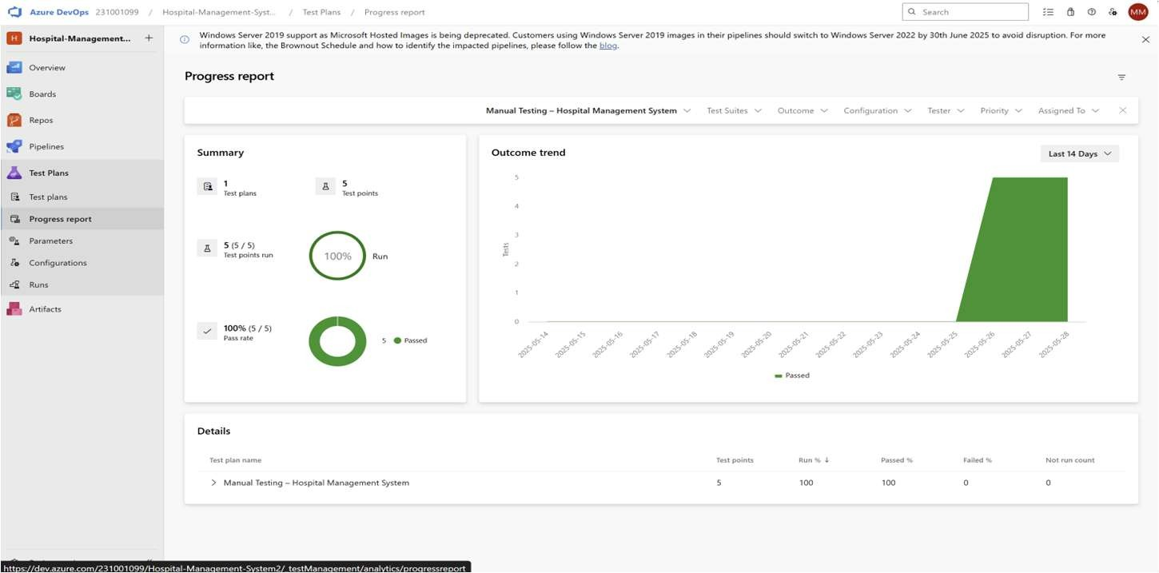

Slide 32
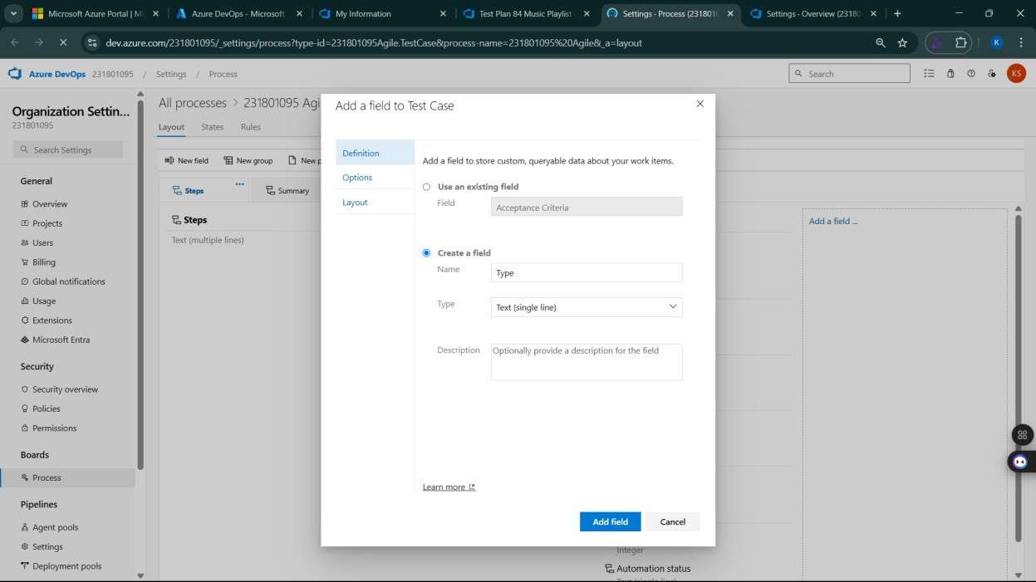
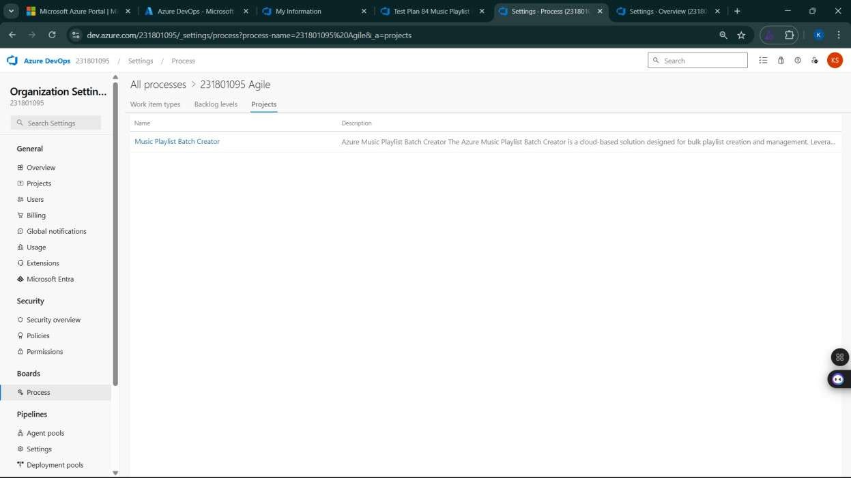
12.View the new test case template

Slide 33
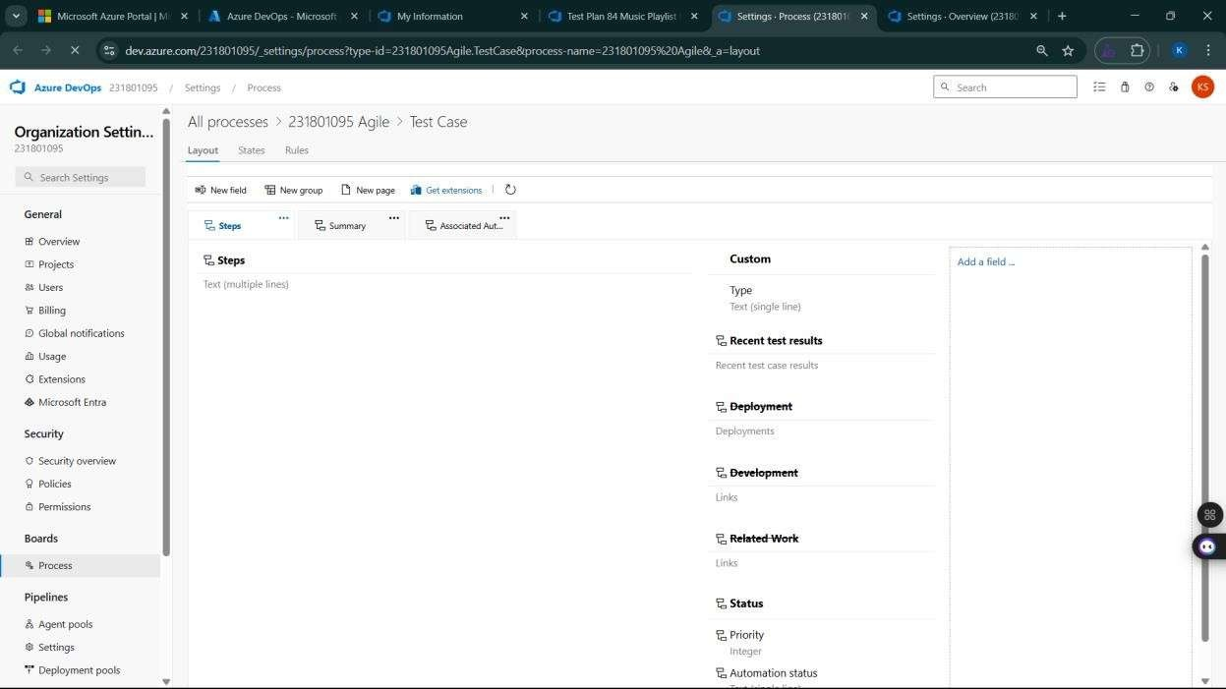
Result:
The test plans and test cases for the user stories is created in Azure DevOps with Happy Path and
Error Path

Slide 34
EXP NO: 9
LOAD TESTING AND PERFORMANCE TESTING
Create Epic, Features, User Stories, Task
Aim:
To create an Azure Load Testing resource and run a load test to evaluate the performance of a target
endpoint.
Load Testing
Steps to Create an Azure Load Testing Resource:
Before you run your first test, you need to create the Azure Load Testing resource:
Sign in to Azure Portal
Go to https://portal.azure.com and log in.
Create the Resource
Go to Create a resource → Search for “Azure Load Testing”.
Select Azure Load Testing and click Create.
Fill in the Configuration Details
Subscription: Choose your Azure subscription.
Resource Group: Create new or select an existing one.
Name: Provide a unique name (no special characters).
Location: Choose the region for hosting the resource.
(Optional) Configure tags for categorization and billing.
Click Review + Create, then Create.
Once deployment is complete, click Go to resource.
Steps to Create and Run a Load Test:
Once your resource is ready:
Go to your Azure Load Testing resource and click Add HTTP requests > Create.
Basics Tab
Test Name: Provide a unique name.
Description: (Optional) Add test purpose.
Run After Creation: Keep checked.
Load Settings
Test URL: Enter the target endpoint (e.g., https://yourapi.com/products).
Click Review + Create → Create to start the test.

Slide 35

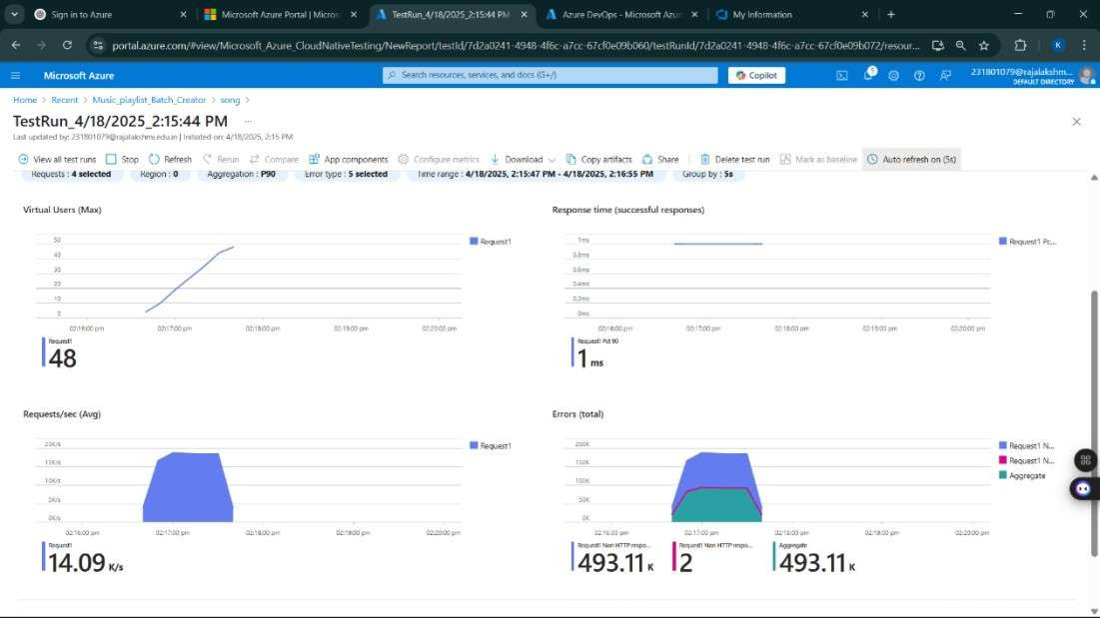
Load Testing

Slide 36
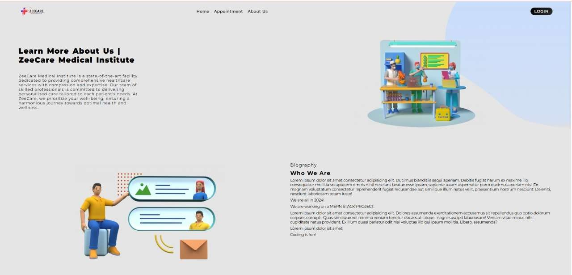
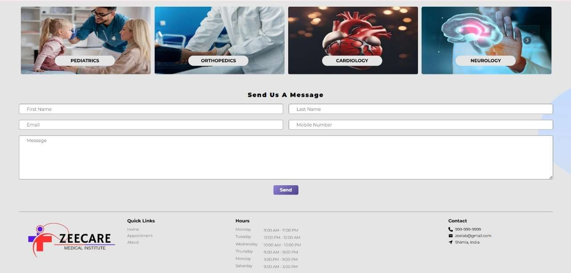
Result:
Successfully created the Azure Load Testing resource and executed a load test to assess the
performance of the specified endpoint.

Slide 37
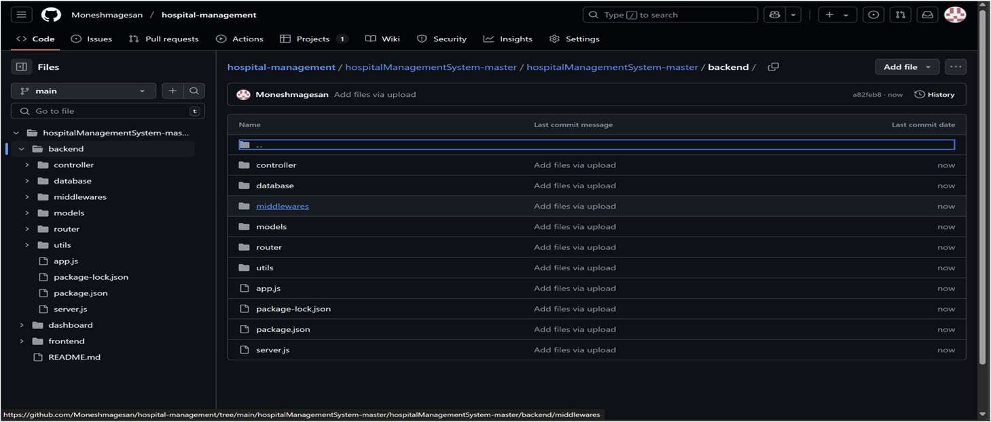
EXP NO: 10
GITHUB: PROJECT STRUCTURE & NAMING CONVENTIONS
Create Epic, Features, User Stories, Task
Aim:
To provide a clear and organized view of the project's folder structure and file naming conventions, helping contributors and users easily understand, navigate, and extend the Hospital management Creator project.
GitHub Project Structure
Result:
The GitHub repository clearly displays the organized project structure and consistent naming
conventions, making it easy for users and contributors to understand and navigate the codebase.

